Slide 1

POWER BI PROJECT PRESENTATION

Slide 2
CYCLISTIC COMPANY

Slide 3

Cyclistic, is a bike-share company operating in the vibrant city of Chicago.
Cyclistic ensures that riders can easily find and return bikes as they navigate the city.
Brief Intro
The service caters to both casual riders, who use the bikes occasionally for leisure or short trips, and annual members, who rely on Cyclistic for their daily commutes and regular transportation needs.

Slide 4

Problem Statement
Director’s Point
Success Program
Two Group Strategies
The company's future success hinges on maximizing the number of annual memberships.
While the bike-share program has seen substantial usage from both casual riders and annual members
Understanding the distinct usage patterns and preferences of these two groups is crucial

Slide 5
Objectives of the Study
Primary Objective
Marketing Strategy Development:
Long Term
analyze the usage patterns of Cyclistic bikes by casual riders and annual members.
Develop targeted marketing campaigns and promotions aimed at converting casual riders to annual members.
By leveraging these insights, Cyclistic aims to increase its annual membership base, thereby ensuring long-term growth.

Slide 6
DATA MODELING
- DATA RELATIONSHIP BUILDING

Slide 7
I began by downloading the CSV file from the provided link and converted it into an Excel format. Next, I uploaded the Excel file into Power BI. After loading the data, I performed data cleaning using the 'Transform Data' feature. Following that, I split the single sheet into four separate tables to better organize the data. Once the cleaning process and data organization were complete, I proceeded to create data models and defined relationships between the different datasets.
Data Modeling

Slide 8

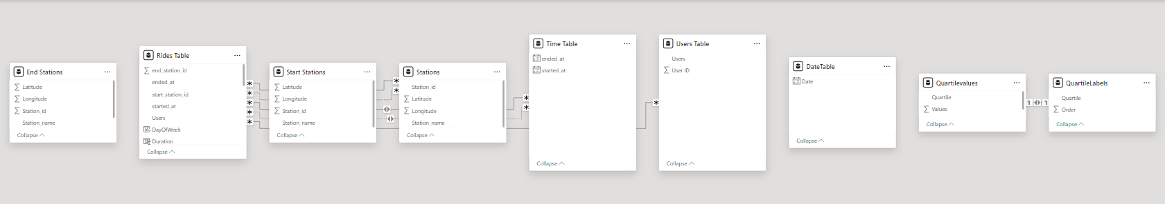
Data Relationships
Elaborate – pic

Slide 9
DATA Visualization
- Rides

Slide 10
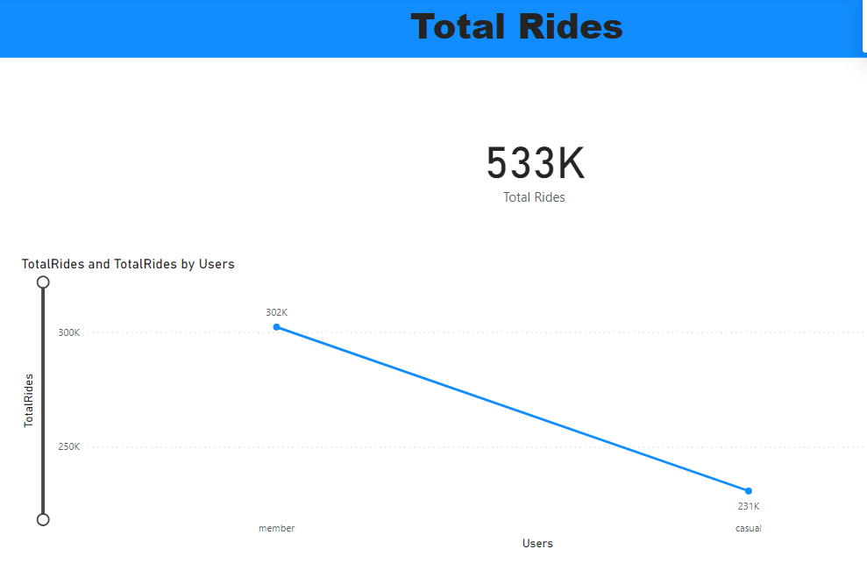
Total Rides
This visual helps stakeholders understand trends over time and anticipate future demand.

Slide 11
From the Total Rides visual, we can easily understand rides by casual users and members.
X = Users
Y = Total Rides
Total Rides 533 K
Member Rides – 302 K
Casual Rides – 231K
Total Rides

Slide 12
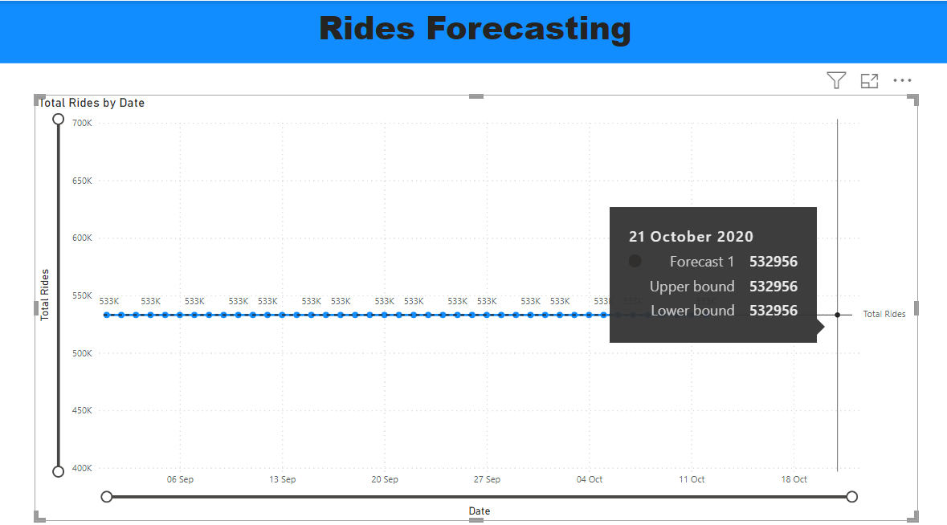
Rides Forecasting
Forecasting done for the future dates

Slide 13
Using a Line Chart, we can predict the future date rides.
From the visual we can easily see the forecasting of rides.
Rides Forecasting

Slide 14
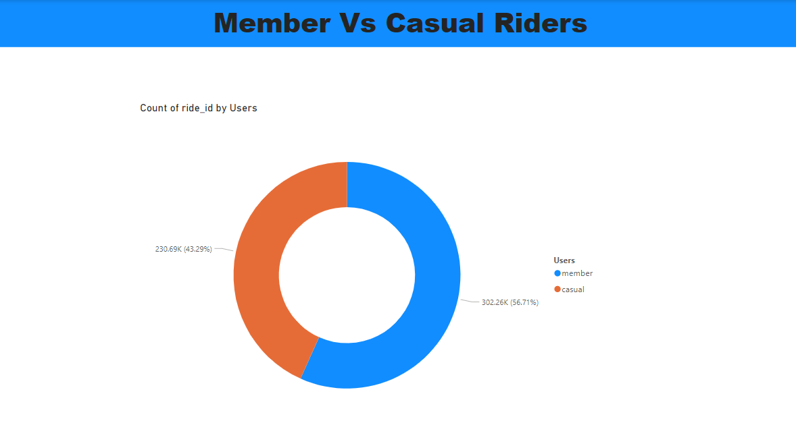
Members Vs Casual
57% of rides done by members
43% of rides done by Casual users

Slide 15
Total Rides: Member vs. casual users explain the usages of rides between member and casual riders.
57% of rides – member
43% of rides – Casual riders
Member Vs. Casual Users

Slide 16
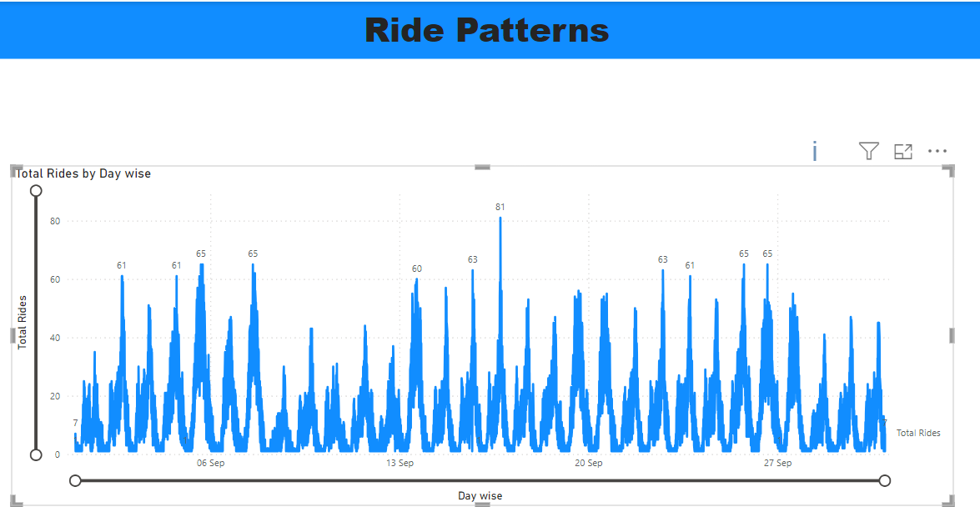
Ride Patterns
Day wise ride patterns

Slide 17
Day-wise Ride Patterns
From visuals, day-wise rides and their count are visible from the chart.
X = Days
Y = rides
Day-wise Ride
Patterns

Slide 18
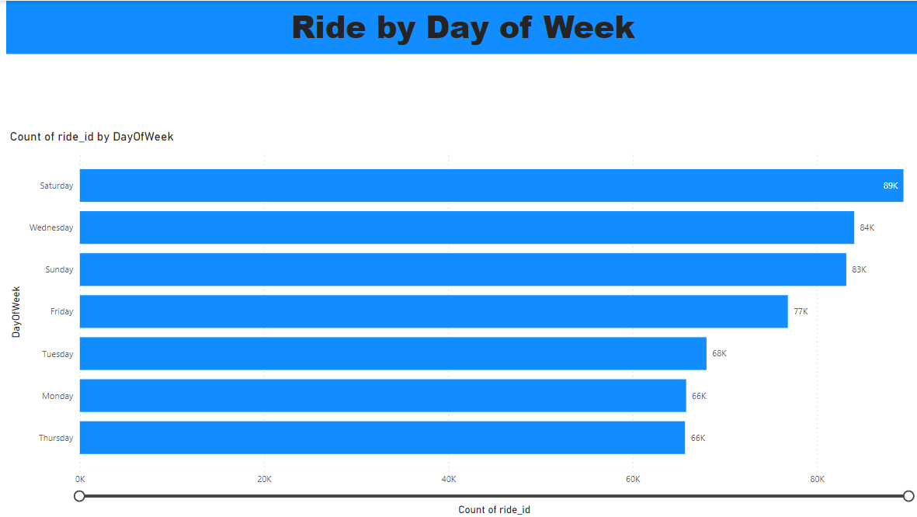
Ride by Day of Week
Which Day highest rides

Slide 19
New Measure found – Day of Week
For this visual, a new measure was found and it shows which day has the highest ride record.
Saturday – 89K
Rides by
Day of Week

Slide 20
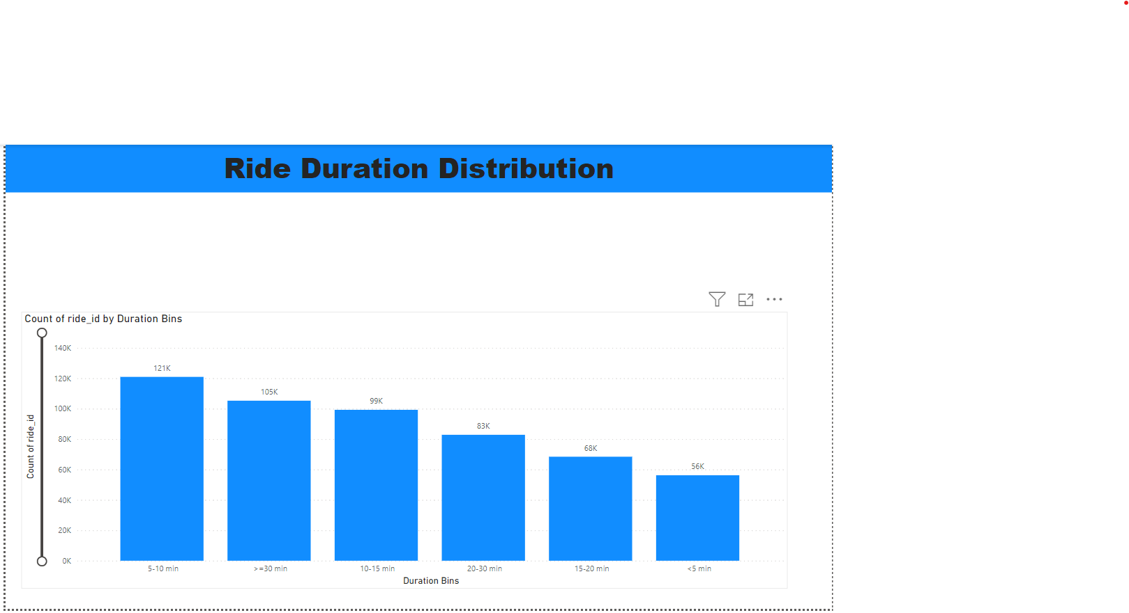
Ride Duration Distribution
Elaborate -

Slide 21
New Measure found – Duration & Duration Bins
Duration and Duration Bins categorize the rides.
Duration bin helps us to understand the highest duration of rides and lowest duration.
We can plan our marketing strategy from duration bins.
Rides Duration
Distribution

Slide 22
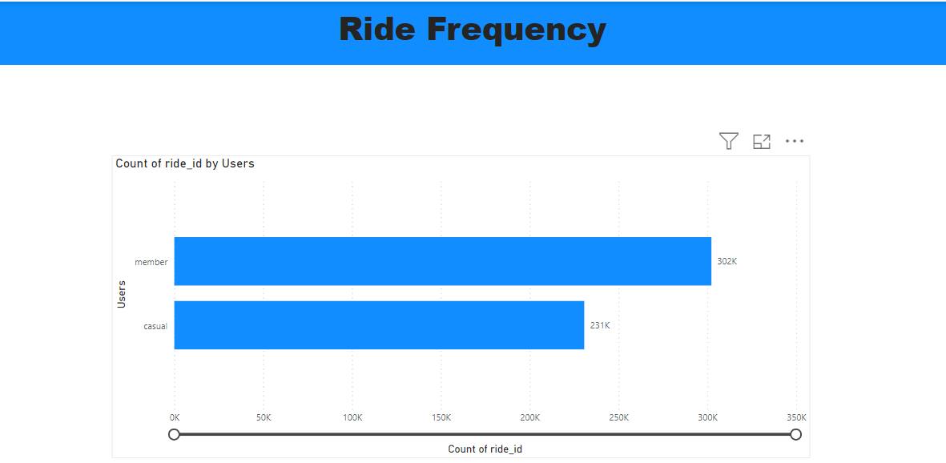
Ride Frequency
Elaborate -

Slide 23
New Measure found – Total Rides
Ride Frequency between casual users and members
we can offer any promotional strategy casual users can become members.
Rides Frequency

Slide 24
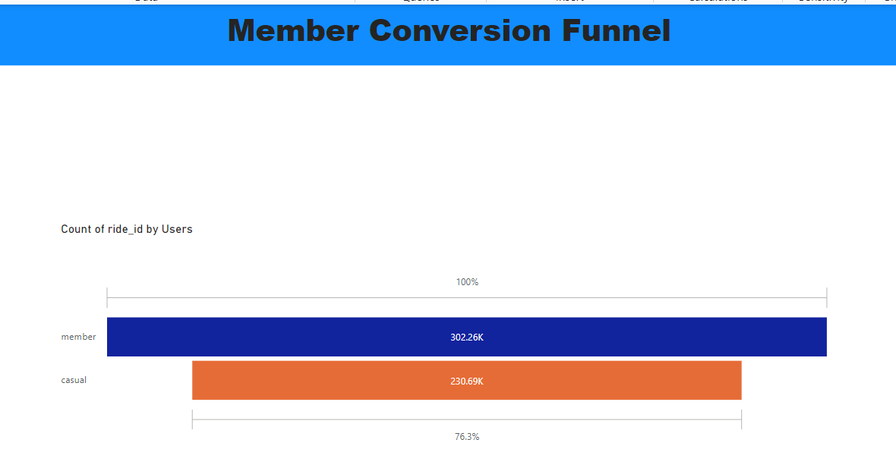
Member Conversion Funnel
Elaborate -

Slide 25
Ride Frequency between casual users and members
76% of Casual users can become members.
Funnel Shows chance of converting casual riders to members.
Member Conversion Funnel

Slide 26
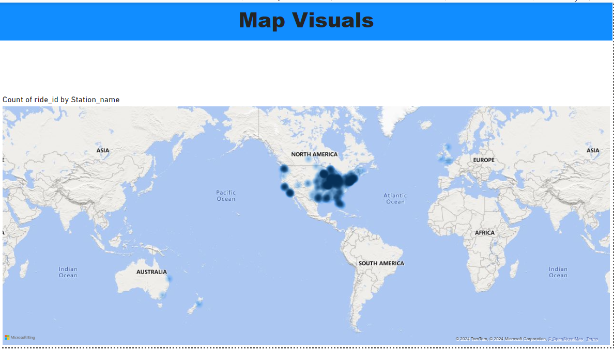
Map Visuals
Elaborate -

Slide 27
Map Visuals
From the Maps, we can understand the routes. Shaded areas are highly used.
I used here Heat maps.
Map Visuals

Slide 28
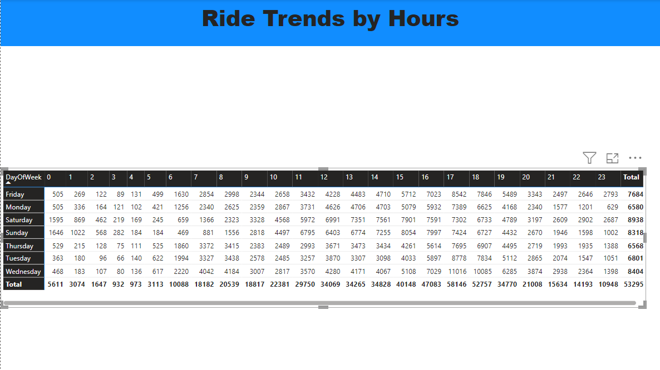
Ride Trends by Hours
Elaborate -

Slide 29
Day of the week and Hours of Day measures used.
It gives the break up every hour and day ride details.
24 hour format
Matrix Table Used
Rows – Day of week
Columns – Hour of Day
Values – Ride ID(Count)
Ride Trends by
Hours

Slide 30
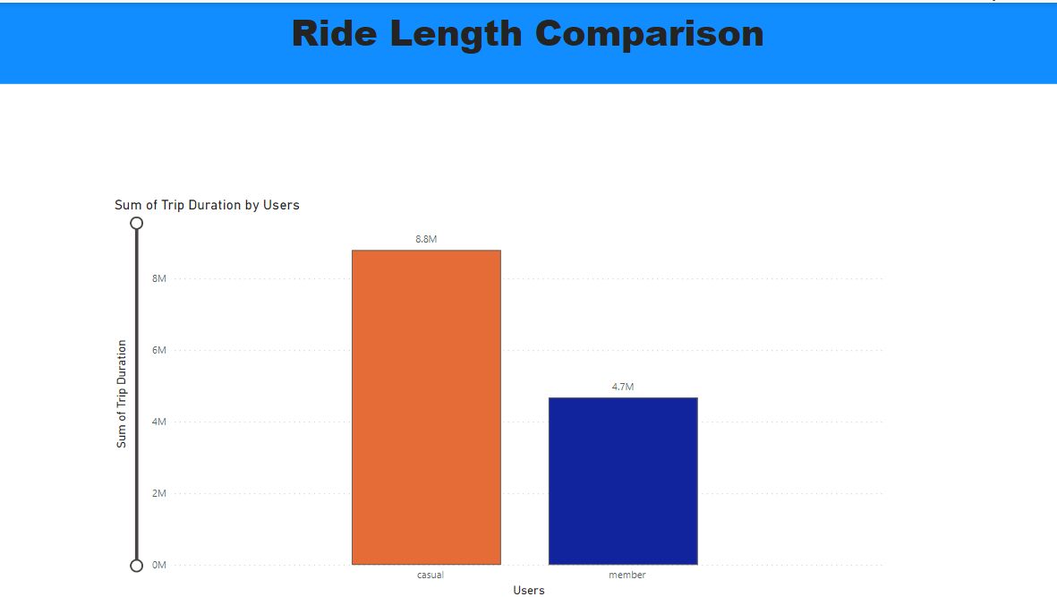
Ride Length Comparison
Elaborate -

Slide 31
Duration – measure found
Casual Rider has the highest duration of trips than members.
Ride Length
Comparison

Slide 32
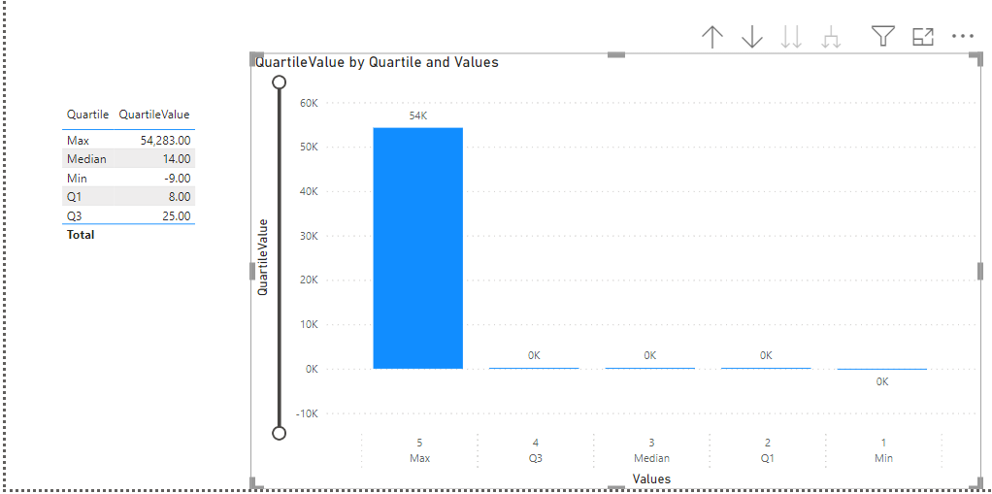
Ride Length Distribution
Elaborate -

Slide 33
New Measures Found – Min Duration, Q1, Median, Q3, Max Duration
Quartile and Quartile Values Distribution
Table View shows Quartile and its values
Graphical representation for the table.
Ride Length
Distribution

Slide 34
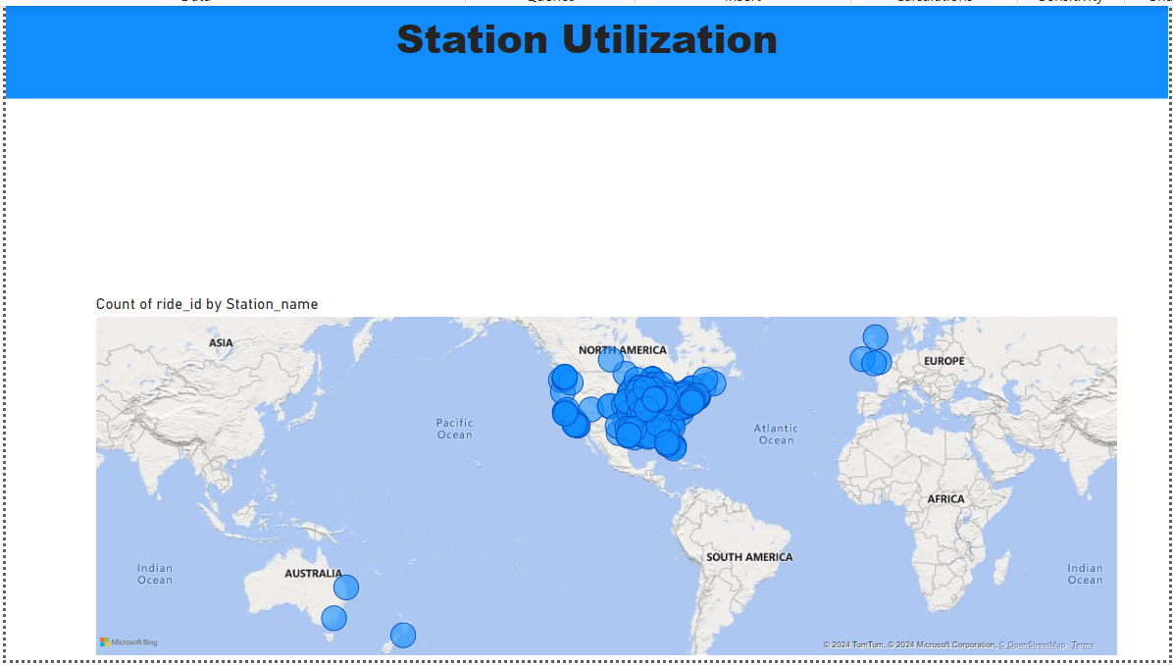
Station Utilisation
Elaborate -

Slide 35
Map visual Used
Bubble view shows station utilizations and its usage.
Station Utilization

Slide 36
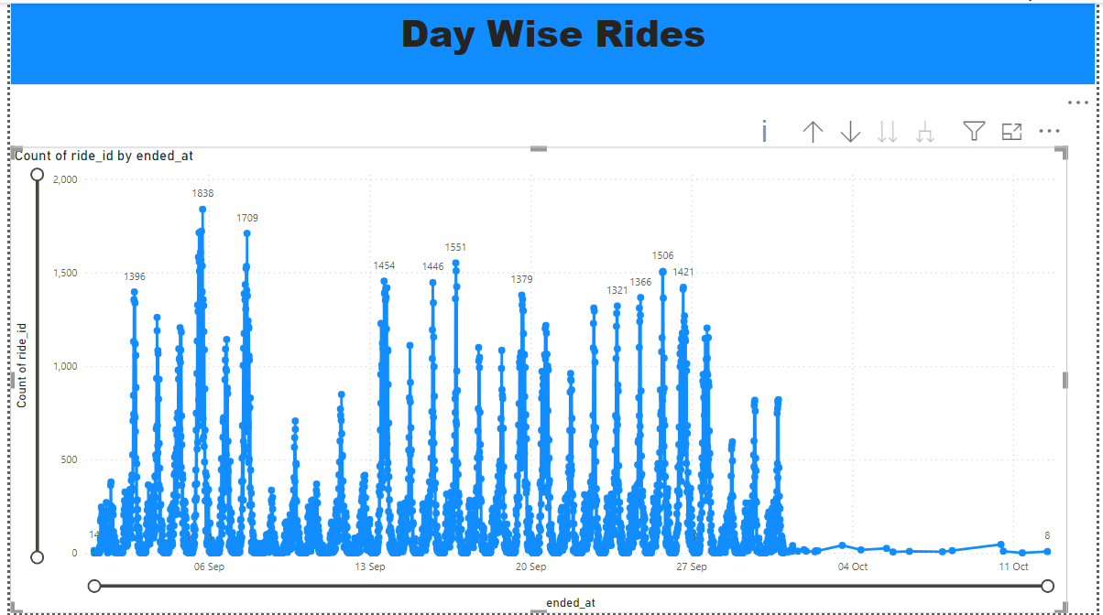
Day wise Trends
Elaborate -

Slide 37
Line chart Used
Day-wise ride trends
Day-wise
Trends

Slide 38
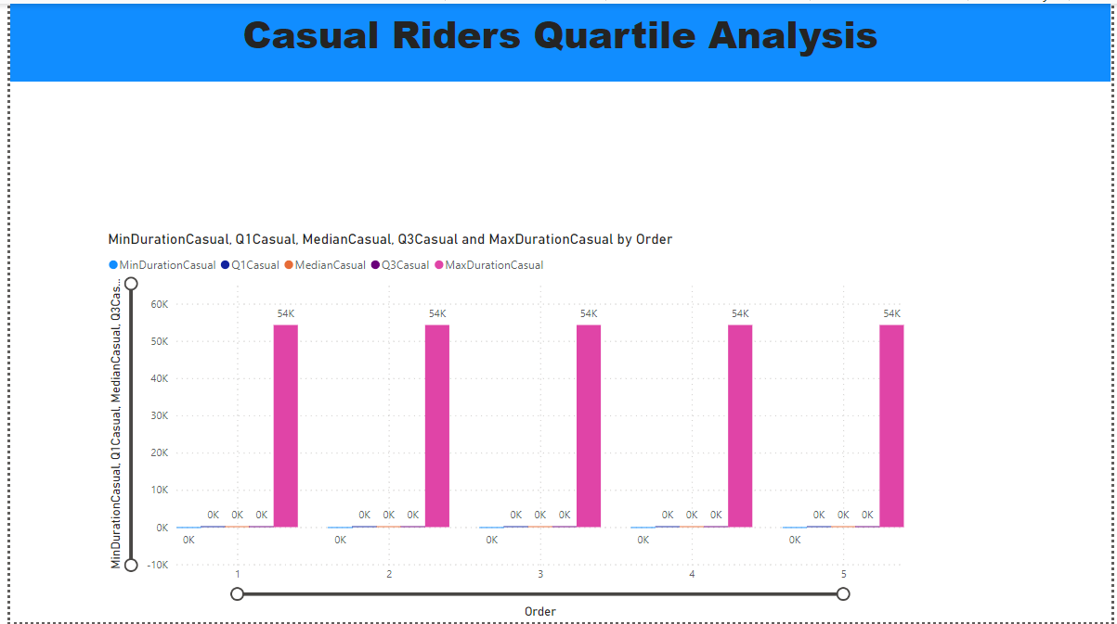
Casual Rider Quartile Analysis
Elaborate -

Slide 39
New Measures found for casual riders
Quartile and Quartile Values
Casual Rider
Quartile Analysis

Slide 40
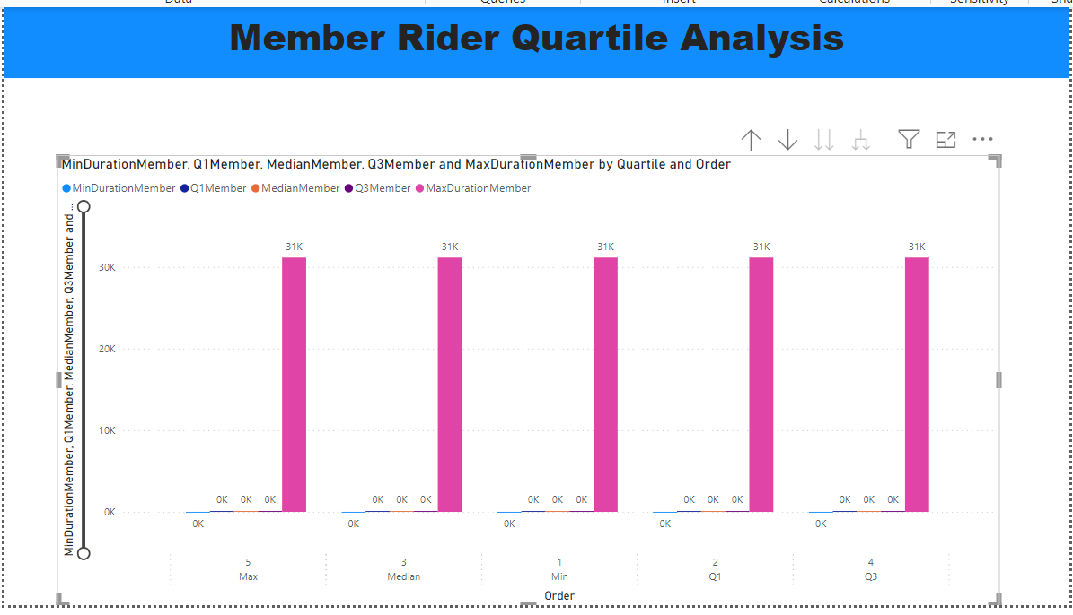
Member Rider Quartile Analysis
Elaborate -

Slide 41
New Measures found for members
Quartile and Quartile values
Member Quartile
Analysis

Slide 42
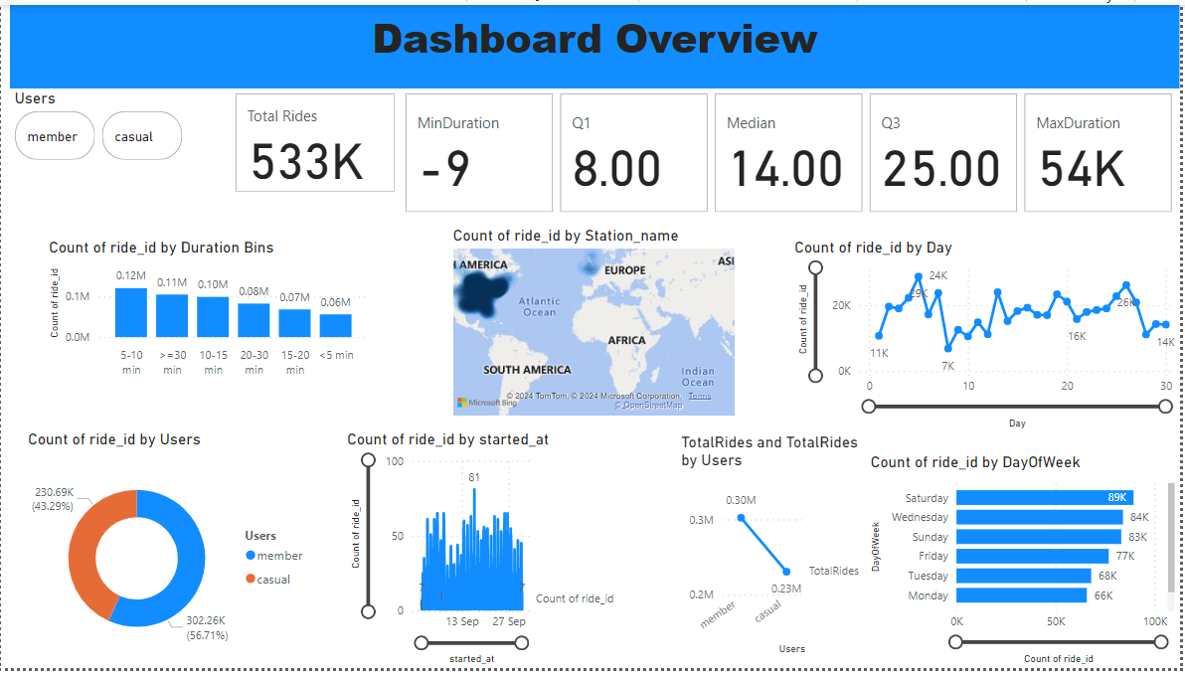
Dashboard
Elaborate -

Slide 43
Dashboard Overview
Dashboard
Overview

Slide 44
Findings & Recommendations

Slide 45
Ride Patterns Differ Significantly Between Casual Riders and Annual Members:
Usage Frequency: Annual members have a higher frequency of rides compared to casual riders. Members often use bikes for daily commutes, while casual riders primarily use them for leisure or occasional trips.
Key Findings

Slide 46
Ride Patterns Differ Significantly Between Casual Riders and Annual Members:
Duration and Distance: Casual riders tend to have longer ride durations compared to annual members, who typically take shorter, more frequent trips.
Key Findings

Slide 47
Ride Patterns Differ Significantly Between Casual Riders and Annual Members:
Peak Usage Times: Both casual riders and members exhibit distinct peak usage times. Members predominantly ride during morning and evening rush hours, whereas casual riders are more active on weekends and holidays.
Key Findings

Slide 48
Popular Routes and Stations:
High-Traffic Stations: Certain stations consistently have high usage, with both casual riders and members frequently starting or ending their trips at these locations. These stations are often near major attractions, parks, and business districts.
Key Findings

Slide 49
Popular Routes and Stations:
Route Preferences: Casual riders prefer scenic and recreational routes, while members favor direct routes that connect residential areas to business districts and public transportation hubs.
Key Findings

Slide 50
Potential for Conversion:
High-Usage Casual Riders: There is a subset of casual riders who use the service frequently enough that they could benefit from an annual membership. These riders represent a prime target for conversion efforts.
Key Findings

Slide 51
Potential for Conversion:
Promotion Timing: Casual riders show increased activity during specific times of the year, particularly in warmer months and during major city events. Targeted promotions during these periods can increase the likelihood of conversion.
Key Findings

Slide 52
Targeted Membership Campaigns:
Personalized Offers: Identify high-usage casual riders and provide them with personalized membership offers. Highlight the cost savings and convenience of becoming an annual member compared to their current spending pattern.
Top 3
Recommendations

Slide 53
Targeted Membership Campaigns:
Seasonal Promotions: Launch promotional campaigns during peak casual rider seasons, such as spring and summer, and around major city events. Offer limited-time discounts and incentives for annual membership sign-ups during these periods.
Top 3
Recommendations

Slide 54
Enhance User Experience at High-Traffic Stations:
Improved Amenities: Enhance amenities at high-traffic stations, such as better signage, bike availability updates, and improved docking station maintenance. Ensuring a smooth experience at these popular locations can increase overall satisfaction and encourage casual riders to consider membership.
Top 3
Recommendations

Slide 55
Enhance User Experience at High-Traffic Stations:
Station-based Incentives: Implement station-based incentives, like rewards for frequent use of certain stations, to encourage casual riders to adopt membership for added benefits and consistent access.
Top 3
Recommendations

Slide 56
Ride Optimization Features:
Route Planning Assistance: Develop and promote route planning features within the Cyclistic app that cater to both casual and member riders. Highlight routes that are popular among members for commuting and those preferred by casual riders for leisure.
Top 3
Recommendations

Slide 57
Ride Optimization Features:
Ride Analytics: Provide riders with personalized ride analytics, showing them their usage patterns, potential cost savings with an annual membership, and health benefits (e.g., calories burned, distance covered). This data can persuade casual riders of the long-term value of membership.
Top 3
Recommendations

Slide 58
Conclusion

Slide 59
In conclusion, Cyclistic stands at a pivotal point where understanding and leveraging rider behavior can significantly impact the company's future growth and success. Our comprehensive analysis has revealed distinct patterns in the usage of Cyclistic bikes by casual riders and annual members. By focusing on these insights, we can craft targeted strategies to convert casual riders into annual members, thereby maximizing revenue and enhancing customer loyalty.
Conclusion

Slide 60

Thank you!

